Slide 1


Name: Ahmed Mamdouh Bayoumi Email: sci.AhmedMamdouh49719@alexu.edu.eg
Unlocking Quantum Efficiency in Image Compression
This presentation delves into a novel quantum image compression method designed for near-term quantum devices, offering significant advancements in qubit efficiency and scalability. We'll explore how histogram-driven amplitude embedding can revolutionize image processing in the quantum realm.
Noisy Intermediate scale Quantum

Slide 2
Introduction
A Leap in Quantum Image Compression
Developed by Sahil Tomar and Sandeep Kumar from the Central Research Laboratory, BEL, Ghaziabad, India, this paper introduces a groundbreaking quantum image compression technique. Published in arXiv:2509.04849v1 [quant-ph] in September 2025, their method promises efficient compression of color images with minimal qubit requirements, making it highly suitable for current NISQ-era quantum hardware.
Before this paper:
1)Flexible Representation of Quantum Images
2)Novel Enhanced Quantum Represntation

Slide 3
Key Innovation
Histogram-Driven Amplitude Embedding
The core of this method lies in its unique approach to image encoding. Instead of encoding individual pixels, the image is divided into fixed-size blocks, termed "bixels." The total intensity of each bixel is calculated, forming a global histogram. The normalized square roots of these histogram bin counts are then embedded as amplitudes into an n-qubit quantum state, where n = ⌈log₂B⌉. This process, facilitated by PennyLane and executed on IBM Quantum hardware, allows for constant qubit usage irrespective of the original image resolution, ensuring remarkable scalability.

Slide 4
Methodology
2. Histogram Formation
1. Bixel-Based Encoding
A global histogram is constructed from the bixel intensities, and the normalized square roots of bin counts are prepared as quantum amplitudes.
Images are segmented into fixed-size blocks, or "bixels," to enable statistical abstraction and calculate the total intensity of each block.
4. Image Recovery
3. Quantum Process
The measured quantum state is used to reconstruct the histogram, allowing for approximate recovery of block intensities and full-image reassembly.
The prepared amplitudes are embedded into an n-qubit quantum state using PennyLane and measured on IBM Quantum hardware to obtain probability distributions.

Slide 5





Core Contributions
Bixel-Based Encoding
Histogram-Driven Compression
Qubit Efficiency
Segments images into blocks for statistical abstraction, significantly reducing data complexity.
Encodes only the global histogram distribution, effectively minimizing dimensionality for compression.
Requires only ⌈log₂B⌉ qubits, a constant number independent of image size, enhancing scalability.
End-to-End Pipeline
Hardware-Compatible
Provides a fully deterministic workflow, ensuring consistent results from preprocessing to reconstruction.
Validated on IBM Quantum hardware under realistic noise conditions, proving its practical applicability.

Slide 6

Performance Metrics
Empirical Results and Advantages
Achieved PSNR > 38 dB with just 5 qubits (32 bins), demonstrating high fidelity in image reconstruction.
Mean Squared Error (MSE) ≈ 0.0025, indicating minimal reconstruction error.
Execution time under 0.4 seconds on real hardware, highlighting impressive speed.
Outperforms classical methods like FRQI, NEQR, and NCQI in qubit efficiency, requiring significantly fewer resources.
Supports arbitrary image sizes and aspect ratios without strict constraints, offering broad applicability.

Slide 7
Code Snippet Analysis
from PIL import Image
import numpy as np
from qiskit import QuantumCircuit
from qiskit_aer import AerSimulator
import matplotlib.pyplot as plt
def bixel_encoding(image, bixel_size=(16, 16)):
h, w, c = image.shape
bixel_h, bixel_w = bixel_size
pad_h = (bixel_h - h % bixel_h) % bixel_h
pad_w = (bixel_w - w % bixel_w) % bixel_w
padded_image = np.pad(image, ((0, pad_h), (0, pad_w), (0, 0)), mode='constant')
h_p, w_p, _ = padded_image.shape
bixel_sums = []
bixel_weights = []
The provided Python code illustrates the end-to-end implementation of the quantum image compression method. Key functions include bixel_encoding for image segmentation, histogram_formation for amplitude preparation, quantum_process for quantum state initialization and measurement, and recover_image for reconstructing the image from measurement outcomes. This modular design facilitates a clear and efficient workflow.

Slide 8
Conclusion
A Path to Scalable Quantum Imaging
The proposed histogram-driven amplitude embedding method offers a practical, scalable, and resource-efficient framework for quantum image compression, ideally suited for current NISQ-era devices. Its ability to achieve high-fidelity reconstruction with extremely low quantum resources opens new frontiers for quantum applications.
Key Takeaways:
Efficiency: Achieves high compression with minimal qubit usage.
Scalability: Constant qubit usage independent of image resolution.
Practicality: Validated on real quantum hardware, suitable for near-term devices.
Impact: Revolutionizes image processing for secure communication, medical imaging, and beyond.

Slide 9

UChicago-Led Quantum Supercomputer
Initiative Secures $4M NSF Grant
The University of Chicago and its partners have received a $4 million grant from the National Science Foundation (NSF) to advance the Quantum Advantage-Class Trapped Ion System (QACTI) project. This funding propels the National Quantum Virtual Laboratory (NQVL) consortium toward its ambitious goal: designing a quantum supercomputer with unparalleled accessibility.
Phase 2 Targets:
1
2029: 60-qubit "proof of concept" machine
2033: 256-qubit ion trap computer
Democratizing Access:
2
The project aims to make advanced quantum hardware available nationwide, both locally and via the cloud, fostering an open quantum platform for scientific applications.
Collaborative Power:
Led by co-principal investigator Fred Chong from UChicago, this initiative involves leading researchers from Duke, Tufts, North Carolina State, and North Carolina Agricultural and Technical State University.
Impact Beyond Research:
Workforce Development: Training the next generation of quantum scientists, including diverse students, postdocs, and professionals.
Grand Challenges: Utilizing quantum computing to tackle complex problems in climate modeling, drug discovery, and other fields currently beyond the reach of conventional computers.
Source: Quantum Computing Report (September 5, 2025)

Slide 10
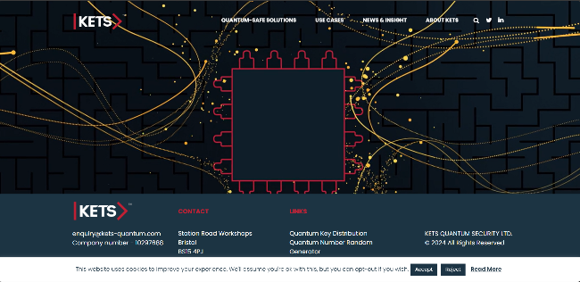
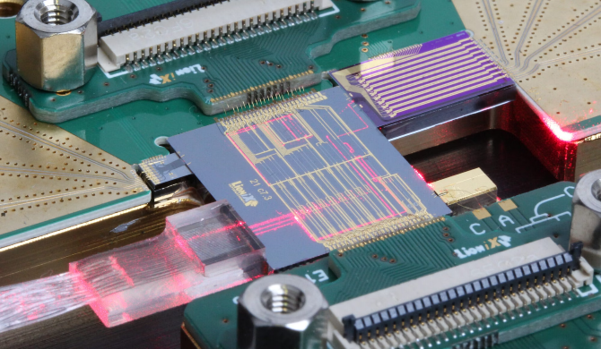
KETS Quantum Security: Pioneering Integrated Photonic Solutions
KETS Quantum Security, based in Bristol, UK, is at the forefront of quantum-secured communications. They specialize in developing cutting-edge technologies that redefine data protection in an increasingly quantum-vulnerable world.
Their core offerings include quantum key distribution (QKD) for unbreakable cryptographic keys and quantum random number generation (QRNG) for truly unpredictable randomness—essential components for robust security.
What sets KETS apart is their innovative use of integrated photonic technologies. This approach enables unprecedented miniaturization, cost-effective manufacturing, and the integration of complex functionalities into compact devices.
Beyond product development, KETS offers comprehensive consulting and joint development services. They partner with SMEs and global corporations to custom-develop quantum-secured solutions tailored to specific needs, accelerating the adoption of next-generation security.

